Slide 1
Citizen participation in local development
Methods, tools and lessons learned from 11 pilots across the EU
26 November 2025
Giulia Cibrario
Policy Analyst
Open Governance Unit
OECD Public Governance Directorate

Slide 2
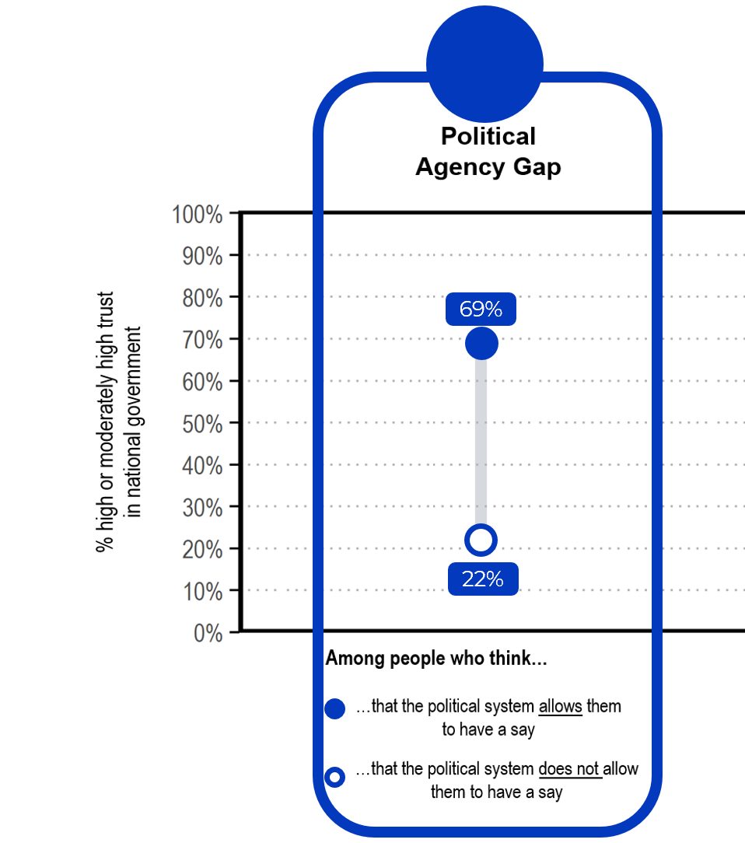
What is citizen participation and why does it matter?
Definition of citizen participation
Key Figures on Participation and Trust
All the ways in which citizens and stakeholders can be involved in the policy cycle and in service design and delivery.
2017 OECD Recommendation of the Council on Open Government
The perception of political agency is the strongest driver of trust in government.
Benefits of citizen participation
Intrinsic benefits
Fostering citizens’ sense of political influence
More democratic legitimacy of decision-making processes
Build trust in government.
Instrumental benefits
Improved policy effectiveness and efficiency
Increased policy acceptance by citizens

Slide 3
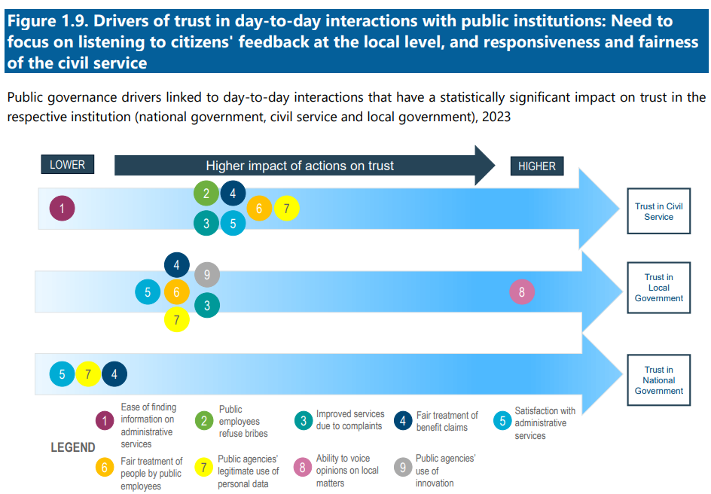
What is citizen participation and why does it matter?
Source: OECD Trust Survey 2023

Slide 4

OECD Guidelines for Citizen Participation Processes
The OECD Guidelines for Citizen Participation Processes provide policymakers and practitioners with practical, implementation-oriented guidance on the design, implementation, evaluation, and institutionalisation of citizen participation in policymaking.
Outlines 10-step implementation plan
Aimed at all levels of government​
Focused on citizen rather than stakeholder participation
Provides in-depth guidance on 8 citizen participation methods:
Includes examples from 15+ countries​
Outlines 9 Guiding Principles for Citizen Participation Processes
Data / Access to information Townhall meetings Public consultations Open innovation: crowdsourcing, hackatons, and public challenges | Citizen Science Civic monitoring Participatory budgeting Representative deliberative processes

Slide 5
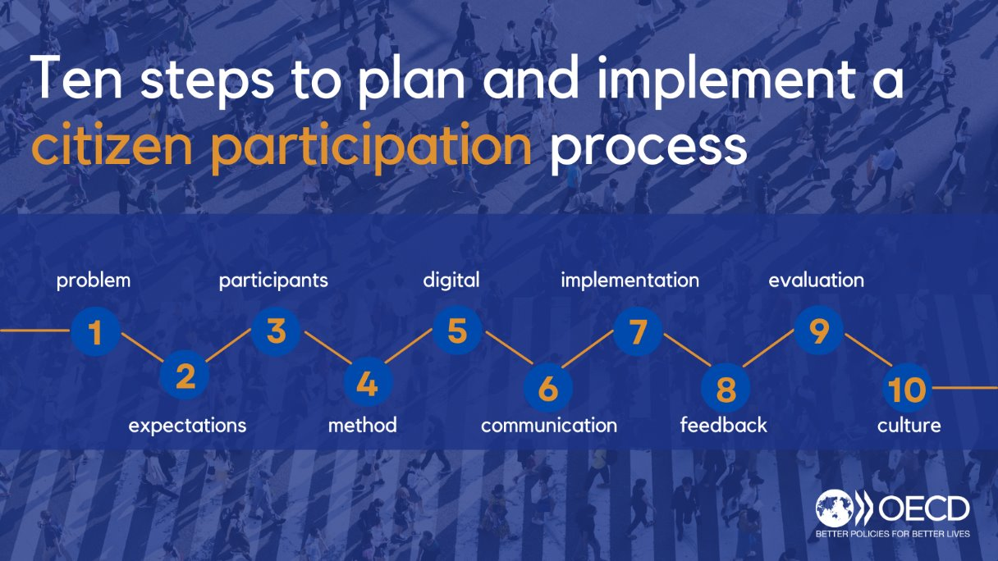

Slide 6
Participation in Practice
Insights from 11 pilots across the EU

Slide 7
Participation in practice: insights from 11 pilots across the EU
Innovative Implementation of the Partnership Principle in EU Cohesion Policy
Framework
Objective
Format
Collaboration with the European Commission – DG REGIO since 2020.​​
First cohort of 5 selected pilot territories to explore the opportunities and challenges of citizen participation in the implementation of EU Cohesion Policy (Phase I)
Second cohort of 11 selected pilot territories across 7 European countries to design and implement tailored citizen participation processes in the management of EU Cohesion Policy Instruments. (Phase II)
To experiment and create the conditions to instiutionalise innovative practices of citizen participation in the management and monitoring of Cohesion Policy instruments (ERDF, ESF+, JTF) at the subnational level (regional and municipal).​​
Partnership with local authorities (Managing Authorities of Cohesion Policy Instruments or Beneficiaries) and with local Civil Society Partners.​​
Technical support in the design and implementation, of citizen participation processes at the local level applied to Cohesion Policy. ​​
Peer learning, evaluation and recommendations to address common challenges.

Slide 8








Participation in practice: insights from 11 pilots across the EU
Besaya’s Citizen Jury and Citizen Commission in Cantabria, Spain
Citizen inputs on the government budget in Catalunya, Spain
Guidelines and Deliberative Assembly to co-design urban mobility in GZM Metropolis, Poland
Development of a toolkit for citizen engagement in Brussels Region, Belgium
13
11
Pilot projets
to discover, experiment, and institutionalise innovative citizen participation in EU Cohesion Policy
Ideathon on Territorial Strategies in Banská Bystrica, Slovakia
Civic monitoring of Territorial Strategies in Lazio, Italy
Deliberative assembly on the cultural spaces in Normandy, France
7
European countries
Participation Playbook and Student Assembly on local Innovation Hubs in Emilia-Romagna, Italy
Citizen Jury on greening mobility in Ramnicu Valcea, Romania
Local Dialogues on Territorial Strategies in South Muntenia, Romania
Citizen Participation in infrastructure projects in Silesia, Poland

Slide 9





Participation in practice: insights from 11 pilots across the EU
LESSONS LEARNED - Success Factors
Local Champions
Ecosystem
Deliberation
Policy Areas
Digital Tools
Political and administrative commitment
Knowledgeable and committed non-public stakeholders
Safe space for experimentation
European Network and community of practitioners
Representative deliberative processes as an opportunity to strengthen social cohesion and create bridges among citizens.
Citizen participation is crucial to meaningfully design and implement green transition policies.
Digital tools for participation allowed to expand and enable multiple formats of participation as part of a same process.

Slide 10
Participation in practice: insights from 11 pilots across the EU
LESSONS LEARNED - Challenges
Stages of the Policy Cycle
Untapped potential of citizen participation at different stages of the policy cycle
Coordination
Limited coordination and integration of efforts deployed at different levels of governance
Skills and Resources
Lack of dedicated skills and tools for participation within and outside of governments.
Lack of financial and human resources dedicated to participation.
Institutionalisation
Lack of institutionalisation:
Many participation process remain ad hoc and one-off exercises.
Legal obstacles to implement citizen participation processes (e.g. access to electoral lists for civic lottery).
Unclear connection to decision making and government’s ‘back office’

Slide 11
Participation in practice: insights from 11 pilots across the EU
LESSONS LEARNED - Good practices to achieve meaningful and impactful participation
Set strong vertical and horizontal coordination mechanisms between levels of governance
Build skills and foster a culture of participation.
Support the inclusion of underheard and vulnerable publics.
Leverage innovation and provide space for experimentation
Institutionalise citizen participation to remove legal obstacles and to ensure the lasting connection with decision-making.
1
2
3
4
5

Slide 12
Leveraging digital technologies and AI to support and enhance citizen participation

Slide 13
Leveraging Digital Technologies and AI to support and enhance citizen participation
The OECD understands Civic Tech as “the use of digital technologies to reinforce democracy by enabling the public to be informed, participate in decision and policymaking, and increase governments’ responsiveness and accountability.”
OECD countries are mainstreaming the use of digital technologies to better inform, communicate and interact with the public.
Almost all OECD countries have deployed a digital portal dedicated to informing about participation opportunities or to carrying out online consultation and participatory processes.
Countries are experimenting with emerging technologies for open government and citizen participation.
Nevertheless, important challenges persist. In particular, digital technologies can create new exclusions and undermine information integrity and civic space.
PUBLIC INSTITUTIONS
Increases democratic participation and government accountability
Online Consultations, digital deliberation, e-petitions, chatbots, or crowd-law platforms, among others.
CITIZENS
Promotes a healthy, diverse, and active civic space
Civic crowdfunding, online forums, online campaigning, and tools to tackle mis- and disinformation, among others
NON-GOVT STAKEHOLDERS

Slide 14

Leveraging Digital Technologies and AI to support and enhance citizen participation
Tackling civic participation challenges with emerging technologies
Beyond the technological hype, how can governments leverage emerging technologies to improve participation?
Analysis of 8 challenges of citizen participation (trust, impact, institutionalization, accessibility, design, isolation, integrity, and resources)
Evidence from literature and implemented case studies on 3 emerging technologies: AI, blockchain, and virtual/augmented reality
Assessment of risks and mitigation strategies
This Policy Paper is one of the deliverables of the project “Improving Civic Participation with Emerging Technology” with Portugal, Spain and the Netherlands, funded by the European Commission under the Technical Support Instrument
https://oe.cd/60N

Slide 15



Leveraging Digital Technologies and AI to support and enhance citizen participation
Tackling civic participation challenges with emerging technologies
Emerging Technologies can address the challenges of citizen participation.
AI stands out as the most promising emerging technology. AI tools present relevant opportunities to improve and create new bridges between governments and citizens by:
Supporting and empowering citizens in navigating government complexity and being able to voice their opinions and priorities,
Expanding government capacity to listen to and to take citizen voices into account when making decisions.
This Policy Paper is one of the deliverables of the project “Improving Civic Participation with Emerging Technology” with Portugal, Spain and the Netherlands, funded by the European Commission under the Technical Support Instrument
Artificial intelligence
Blockchain
IMPACT
ISOLATION
TRUST
ACCESSIBILITY
INTEGRITY
RESOURCES
Virtual and augmented realities
DESIGN
ACCESSIBILITY

Slide 16
Leveraging Digital Technologies and AI to support and enhance citizen participation
AI and the Future of Citizen Participation
Typology of applications, opportunities and challenges for democratic innovations.
In collaboration with Bertelsmann Stiftung
Objectives
Conduct an in-depth analysis of AI opportunities for citizen participation and open government
Provide governments and practitioners with a practical tool (Typology)
Analyse the risks and challenges of the adoption of AI through the lenses of open government and provide relevant mitigation strategies.
Methodology
Literature review
Analysis of 50+ case studies from 22 countries of uses of AI for citizen participation and other open government practices.
Artificial intelligence
IMPACT
ISOLATION
ACCESSIBILITY
RESOURCES
DESIGN

Slide 17
Leveraging Digital Technologies and AI to support and enhance citizen participation
OECD Typology of AI tools to improve and enhance citizen participation
Government
Internal government operations
Back-office of participation
Improving resource allocation
Enhancing accessibility
Enabling quality participation at scale
Improving design
Sense-making
Information curation
Translation
Transcription
Virtual Assistance
Facilitation
Moderation
Simulation
Architect
Citizen-government interface
Front-office of participation
Citizens

Slide 18
Leveraging Digital Technologies and AI to support and enhance citizen participation
Preliminary Findings: governments are using AI to support
and improve citizen participation
Sense-making, Virtual Assistance and Translation tools are becoming widespread
Uptake of Applications
“Augmenting” deliberation emerges as a priority
Among more mainstream participation processes at the national level, improving public consultation is an area of interest.
Types of Participatory Processes
Innovation Champions
Local level pushing the boundaries of experimentation,
at limited scale and often in pilot experiences.
Beyond application-based AI tools
Reflection on Agentic AI for citizen participation: beyond task-specific tools, towards holistic AI agents acting as participation officers or to represent citizens.
Augmented collective intelligence – AI/Human policymaking
N = 50
Source: AI and the Future of Citizen Participation (forthcoming)

Slide 19
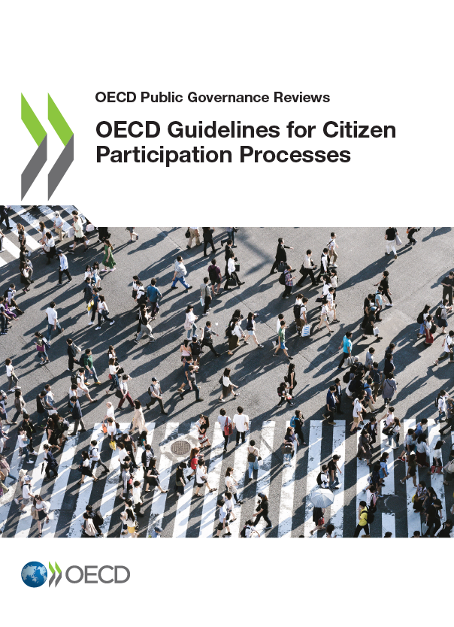

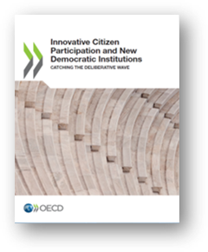
Resources
OECD Resources on Innovative Citizen Participation
Project « Innovative Implementation of the Partnership Principle in EU Cohesion Policy
Deliberative Toolbox
Participation for the Green Transition
Leveraging Digital Technologies and AI
OECD Guidelines for Citizen Participation Processes
OECD Report Engaging Citizens in Cohesion Policy
OECD Case Study Implementing Citizen Participation at all Stages of the EU Cohesion Policy Cycle
OECD Report Innovative Citizen Participation and New Democratic Institutions – Catching the Deliberative Wave
Good Practice Principles for Deliberative Processes for Public Decision-making
Evaluation Guidelines for Representative Deliberative Processes
Eight Ways to Institutionalise Deliberative Democracy
OECD Database of Representative Deliberative Processes
OECD Report Open Government for the Green Transition
OECD Policy Paper Tackling Civic Participation Challenges with Emerging Technologies – Beyond the Hype
OECD Policy Paper AI and the Future of Citizen Participation (forthcoming)

Slide 20
Thank you!
Giulia Cibrario
Policy Analyst
OECD Public Governance Directorate
giulia.cibrario@oecd.org
citizenparticipation@oecd.org

